Slide 1
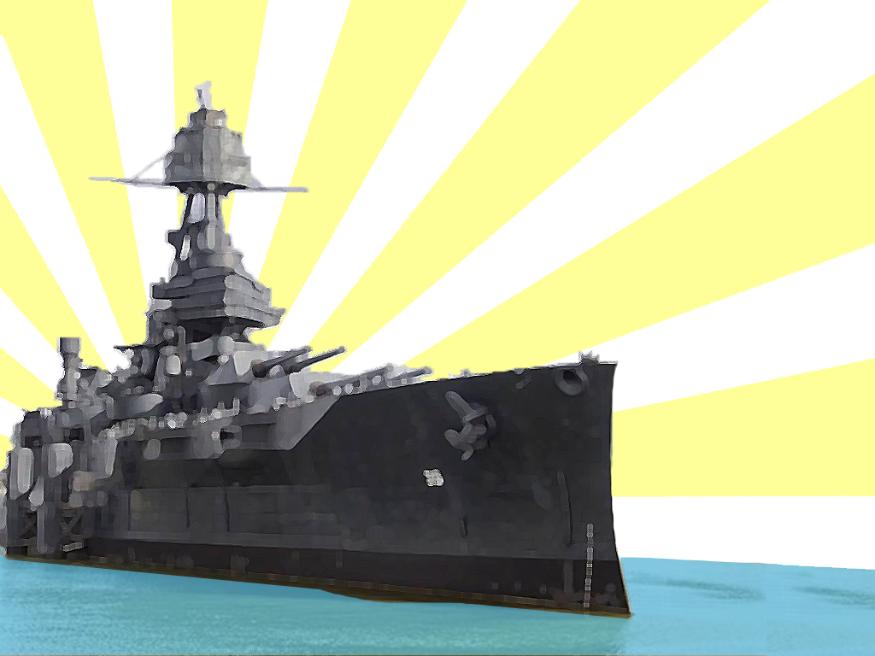

Meta-heuristics
Helder Oliveira, aluno nº 78830
Luciano Neves, aluno nº 78279
Notes:
This game plays just like the popular board game, Battleship®. ***How to set up this game template*** 1. Come up with 32 review questions and answers. 2. Type the questions into the “Type review question here.” text boxes on slides 3-34. One question per slide. 3. Keep a list of the questions and answers with you, so you know what the answers are (just in case you get caught off-guard). ***How to play Battleship***
1. Divide your class into two even teams. It’s fun to do boys vs. girls if the numbers are roughly equal! 2. Have them sit in a groups (with their teams) and have each team select a captain. The captain is the only person who can pick squares and provide answers. It gets too confusing, otherwise. One team is the Red Team and will try to destroy the three ships hiding beneath the blue squares. The other team is the Blue Team and will try to destroy the three ships hiding beneath the red squares. 3. Choose which team will go first. I like to flip a coin. 4. Have the first team select which square they want to attack. Then, click on their selection in the gray “Questions” box. This will take you to the question that corresponds with that square. 5. Read the group the question. Give them 1 minute to discuss and provide an answer. 6. If the answer they provide is correct, click on the “Return to Board” box. Then, click on the box that they selected. IF there is part of a ship behind that box, you can click on the ship and a bomb will explode on it. After the box has been clicked and the ship has been bombed (if applicable), their turn is over and the other team gets to go. NOTE: If both parts of a ship have been destroyed, you can reduce the number of ships remaining in the “Ships Remaining” text box. 7. If the answer they provide is incorrect, click on the “Return to Board” box. Their turn is now over and the other team gets to go. 8. The game continues until one team has successfully destroyed all three of their opponents ships. ***Instructions for repeat gameplay***
1. If you intend to use this template multiple times with the same class, it’s easy for them to remember where the ships (and bombs) are so, you’ll need to move them around. 2. To move the ships, you’ll need to move the red and blue boxes first. The ships (and bombs) are underneath the red and blue boxes. 3. I suggest that you select all of the red and blue boxes (at the same time) and use the “cut” and “paste” function to move them to another slide. This will allow you to keep them all together. You can create an entirely new slide at the end of the PowerPoint and then delete if when you’re done making changes. 4. After you’ve moved the red and blue boxes, you can move the ships (and bombs) where you want them on the game board. Each half of the board should have three ships. Make sure you keep the ships and bombs that are stacked on top of each other together. NOTE: Each of the ships are separated into two halves so that when you click on them during gameplay, both of the bombs do not go off. Each half of the ship is a button, essentially. 5. After you’ve moved the ships (and bombs) to where you want them to be, “cut” and “paste” the red and blue squares back on top of the board. 6. When you’ve made these changes, try playing the game to make sure they work correctly. Don’t forget to delete the extra slide at the end of the presentation (if you made one). © 2012 Any redistribution or reproduction of part or all of the contents in any form is prohibited. You may not distribute or commercially exploit the content. Nor may you transmit it or store it in any other website or other form of electronic retrieval system.

Slide 2

Introduction
We consider this problem a geometrixc problem inspired by the children game ‘Battleship’. The Wikipedia description of this game:
‘Battleship (also Battleships or Sea Battle) is a strategy type guessing game for two players.

Slide 3
Introduction
It is played on ruled grids (paper or board) on which each player’s fleet of ships (including battleships) are marked. The locations of the fleets are concealed from the other player. Players alternate turns calling “shots” at the other player’s ships, and the objective of the game is to destroy the opposing player’s fleet.’

Slide 4
Problem that you will be solving
The user places 5 ships randomly on the game board and the opponent has to sink the ships.
Objective: The opponent hits all ships minimizing the number of missed shots.
Problem classified as NP-complete problems presented on wikipedia at
https://en.wikipedia.org/wiki/List_of_NP-complete_problems

Slide 5




1
2
3
4
5
6
7
8
A
B
C
D
Ships Remaining:
Ships Remaining:
Demo:
A1
A2
A3
A4
A5
A6
A7
A8
B1
B2
B3
B4
B5
B6
B7
B8
C1
C2
C3
C4
C5
C6
C7
C8
D1
D2
D3
D4
D5
D6
D7
D8
Notes:
Notes: You do not need to edit this slide in order to play the game. © 2012 Any redistribution or reproduction of part or all of the contents in any form is prohibited. You may not distribute or commercially exploit the content. Nor may you transmit it or store it in any other website or other form of electronic retrieval system.

Slide 6
Why we need a metaheuristic(s) to solve it
Because the existing solutions do not include the best optimization to solve the problem.
Notes:
Setup Notes: Enter your question into the “Type review question here.” text box. © 2012 Any redistribution or reproduction of part or all of the contents in any form is prohibited. You may not distribute or commercially exploit the content. Nor may you transmit it or store it in any other website or other form of electronic retrieval system.

Slide 7
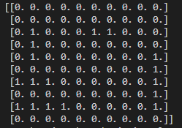
What the search space is (and its size)
10x10 board game, traditional
Notes:
Setup Notes: Enter your question into the “Type review question here.” text box. © 2012 Any redistribution or reproduction of part or all of the contents in any form is prohibited. You may not distribute or commercially exploit the content. Nor may you transmit it or store it in any other website or other form of electronic retrieval system.

Slide 8
Mathematical formulation of the problem
Formally, we treat an m × n-sized Battleships puzzle (m rows and n columns) as a tuple <I,C,R,Fi>
where
I : {1,... ,m} × {1,... ,n} → {ship,water,?}
is a function that represents the initial ﬁlling of the starting grid. For instance, I(i,j) = ship denotes that cell (i,j) contains a ship segment. If I(i,j) = ?, cell (i,j)’s ﬁlling is not given: it is up to the puzzle solver to ﬁll it with either a water or a ship segment.
Notes:
Setup Notes: Enter your question into the “Type review question here.” text box. © 2012 Any redistribution or reproduction of part or all of the contents in any form is prohibited. You may not distribute or commercially exploit the content. Nor may you transmit it or store it in any other website or other form of electronic retrieval system.

Slide 9
Mathematical formulation of the problem
C is a function representing the column tally by adding a number 2 to every column i ∈ {1,... ,n}; idem for the function R representing the row tally, with respect to j ∈ {1,... ,m}. The function F represents the ﬂeet: there are F(k) ships of ship-length k.
Notes:
Setup Notes: Enter your question into the “Type review question here.” text box. © 2012 Any redistribution or reproduction of part or all of the contents in any form is prohibited. You may not distribute or commercially exploit the content. Nor may you transmit it or store it in any other website or other form of electronic retrieval system.

Slide 10
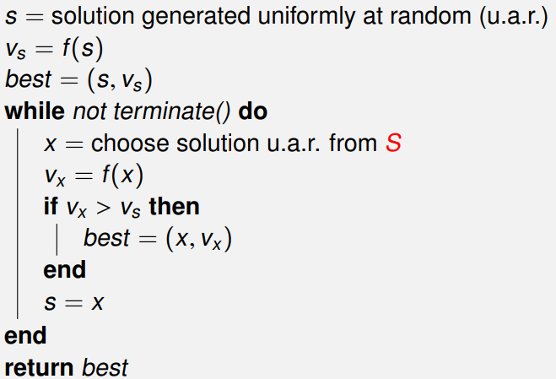
Fitness/objective function that you are optimizing
Algortim: Uninformed Random Picking
Notes:
Setup Notes: Enter your question into the “Type review question here.” text box. © 2012 Any redistribution or reproduction of part or all of the contents in any form is prohibited. You may not distribute or commercially exploit the content. Nor may you transmit it or store it in any other website or other form of electronic retrieval system.

Slide 11
A candidate solution for your problem
1st PHASE randomly run all the boxes in search of the ships and it will mark when it sinks. This is not ideal
2nd PHASE Do a neighborhood search
Notes:
Setup Notes: Enter your question into the “Type review question here.” text box. © 2012 Any redistribution or reproduction of part or all of the contents in any form is prohibited. You may not distribute or commercially exploit the content. Nor may you transmit it or store it in any other website or other form of electronic retrieval system.

Slide 12
Type of instances you will use, and where do you get them from
Not applicable, as the data is entered manually by the user
Notes:
Setup Notes: Enter your question into the “Type review question here.” text box. © 2012 Any redistribution or reproduction of part or all of the contents in any form is prohibited. You may not distribute or commercially exploit the content. Nor may you transmit it or store it in any other website or other form of electronic retrieval system.

Slide 13
Metaheuristcs you plan to implement and apply to your problem
Heuristics we will use:
1º -> Single-state SLS methods , Blind search( Starting from an initial solution, the algorithm wanders around the search space and simply keeps the best solution found so far)
2º -> Hillclimbing - At each time step, move to a neighbour that is better than the current solution
Notes:
Setup Notes: Enter your question into the “Type review question here.” text box. © 2012 Any redistribution or reproduction of part or all of the contents in any form is prohibited. You may not distribute or commercially exploit the content. Nor may you transmit it or store it in any other website or other form of electronic retrieval system.

Slide 14
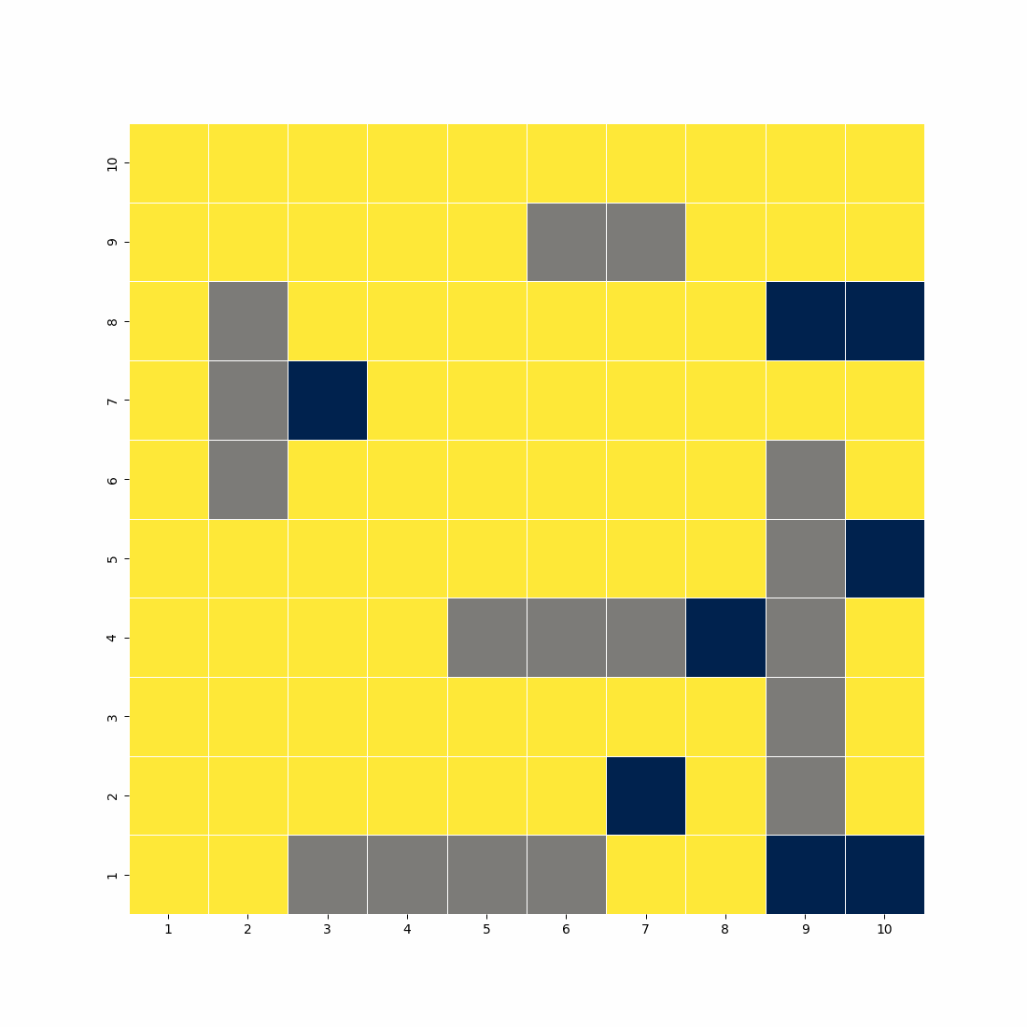
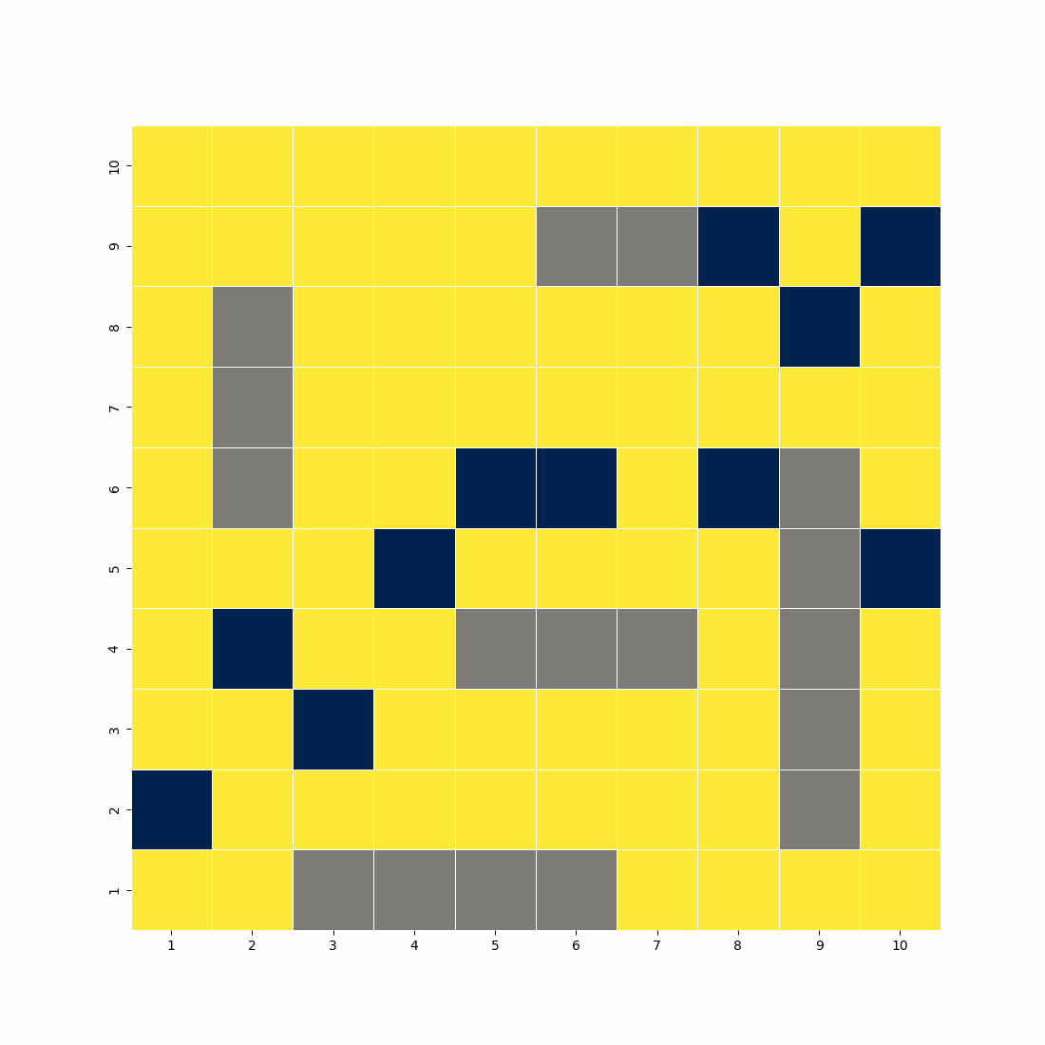
Preliminary results
Busca cega
Hiilclimbing- speed test ramdom
Random search running all the houses and ends when it hits all 17 shots and searches the neighborhood when, using weights when it detects a hit
*Hillclimbing - At each time step, move to a neighbour that is better than the current solution
Notes:
Notas: bla bla bla bla bla bla na apresentação

Slide 15
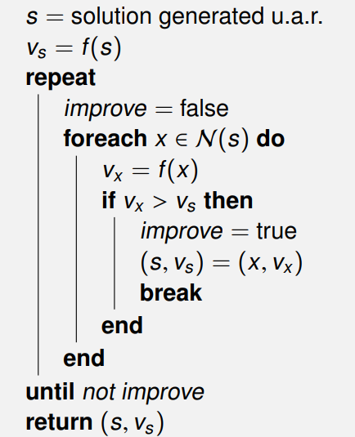
Preliminary results
Next Ascent F visit the neighbourhood in a random order, and move to the first neighbour that improves upon the current solution
Notes:
Notas: bla bla bla bla bla bla na apresentação

Slide 16
Outline of what else needs to be done
Improve the algorithm already built by so that the optimization is the best.
we proved that Battleships puzzles in general cannot be solved effectively. However, Battleships puzzles are often accompanied by their solution, for players to check their solution or to get a hint on how to arrive at the solution.
Notes:
Setup Notes: Enter your question into the “Type review question here.” text box. © 2012 Any redistribution or reproduction of part or all of the contents in any form is prohibited. You may not distribute or commercially exploit the content. Nor may you transmit it or store it in any other website or other form of electronic retrieval system.

Slide 17
Outline of what else needs to be done
Finding the shortest and most efficient search space in this sense we will analyze and improve some algorithms already tested in the past.
Notes:
Setup Notes: Enter your question into the “Type review question here.” text box. © 2022 Any redistribution or reproduction of part or all of the contents in any form is prohibited. You may not distribute or commercially exploit the content. Nor may you transmit it or store it in any other website or other form of electronic retrieval system.

Slide 18
$$Thank you for your attention!$$
© 2022
Notes:
Bla bal

